Slide 1


Noise Measurement and Control
Tri-Service Hearing Technician
4.2 Certification Course

Slide 2
Noise Measurement and Control
Learning Objectives
1.5.1 Explain the purpose and processes for noise assessment
1.5.2 Explain the role of noise controls
1.5.3 Explain how hearing protection attenuation is estimated
1.5.4 Identify personnel who are required to be in the hearing conservation program
1.5.5 Understand the differences between the weighting scales
1.5.6 Understand terminology specific to noise measurement and control
Tri-Service Hearing Technician 4.2 Certification Course

Slide 3
Noise Measurement and Control
Noise Assessment
Noise surveys
  Quantify exposure and determine health risks
Noise control studies
  Characterize the noise hazard for implementing controls
Who measures noise
  Industrial Hygienist (IH), acoustical engineer or other qualified professional
When is noise measured
  Annually
  New or changed equipment or processes, hearing trends
Tri-Service Hearing Technician 4.2 Certification Course
Notes:
Quantify worker’s exposure and determine health risk (characterize noise hazard), assess the noise situation for controls

Slide 4
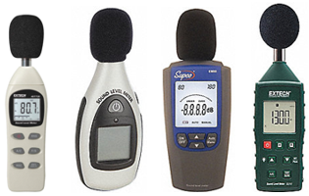
Noise Measurement and Control
Area Noise Surveys
Determine the noise level of particular piece of equipment or area
Sound-level meters (SLM)
  Used for a particular area or equipment
  Type 1 (precision), Type II (general)
  Octave-band analysis (Type 1 SLM)
  Mostly done with Type II general purpose meters (accuracy within 2 dB)
Sound booth background noise certification (required annually)
Tri-Service Hearing Technician 4.2 Certification Course
Notes:
Area noise surveys: mapping of hazardous-noise areas for posting notices, to determine the appropriate hearing protection for that equipment, and/or to determine personnel at risk or not at risk in an environment (who needs to be on a hearing conservation program)
Can also be completed in order to observe the work process of the worker.
Sound level meters (SLM): an instrument used to measure ambient sound in an environment
Type I SLM (precision) vs Type II SLM (general) devices
Octave band analysis (Type I SLM); provides more specific information on the noise energy by frequency through the measurement of the octave band levels, and can determine risk to human hearing more accurately; can be used in order to accurately recommend hearing protection devices (especially in the low frequencies)
Audiometric sound booth certification: Completed for assessment of background noise levels inside of audiometric sound booths using octave band analysis
DoD 6055.12 provides specific background noise limits to ensure ambient noise does not interfere with hearing test results
Required annually
(Images: http://www.keison.co.uk/casellameasurement_cel600soundlevelmeters.shtml; http://www.raeco.com/products/noise/3m-se-400-sound-examiner.html)

Slide 5
Noise Measurement and Control
Noise Hazard Assessment
Identify potentially hazardous noise sources
Determine individuals employed in hazardous noise areas
Identify personnel who should be enrolled in hearing conservation program to Safety (see service-specific guidelines)
Label noise hazardous areas and equipment with appropriate labels
Tri-Service Hearing Technician 4.2 Certification Course
Notes:
Identification of noise hazardous work environments and equipment
Determine individuals and/or work space areas exposed to hazardous noise using measurements obtained with dosimeters or sound level meters.
Noise levels ≥ 85 dBA SPL steady state/continuous noise (8 hour TWA measurement) and/or 140 dBP SPL impulse/impact noise
All Army/USMC service members are enrolled in the HCP regardless of noise exposure
Primarily responsibility of Industrial Hygienist

Slide 6
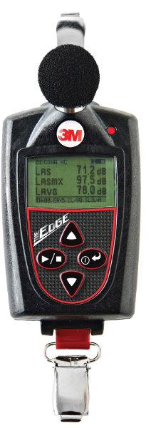
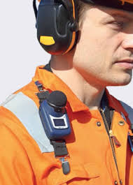
Noise Measurement and Control
Noise Study - Dosimetry
Captures individual exposures over a work shift (TWA)
Measures the average dBA level
Tri-Service Hearing Technician 4.2 Certification Course
Notes:
The goal of Dosimetry is to capture the individual’s noise exposure over a work shift; measures the noise dose from all the exposures over a work shift
Dosimeters are smaller SLM worn near ear-level, often clipped to the shoulder; some dosimeters can be in-ear models
Dosimeters measure, store and analyze noise data, using in dBA and/or dBC or dB SPL scales; they also can measure in different exchanges rates
Some dosimeters provide a time history that can be downloaded and analyzed
Conduct dosimetry over several days with several employees for a good sample of the work environment
(Images: https://www.noisemeters.com/product/cel/dbadge/dbadge2/; http://www.allsafeindustries.com/store/p/5194-Edge-5-Noise-Dosimeter.aspx; https://www.ocn.org.au/guide/244-weighting-dba-and-c-weighting-dbc)

Slide 7
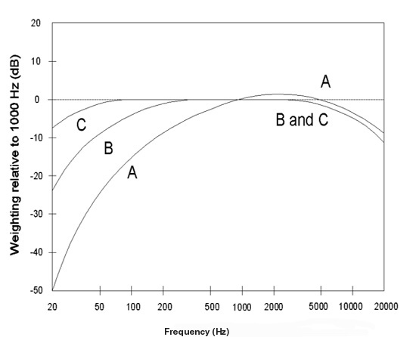
Noise Measurement and Control
Weighting Scales
Changes a measurement to lessen the contributions of low frequencies
The “A” scale mimics how the human ear hears sound
The “C” scale is used to recommend the hearing protector device to use in the noise hazard area
Tri-Service Hearing Technician 4.2 Certification Course
Notes:
(Images: https://www.noisemeters.com/product/cel/dbadge/dbadge2/; http://www.allsafeindustries.com/store/p/5194-Edge-5-Noise-Dosimeter.aspx; https://www.ocn.org.au/guide/244-weighting-dba-and-c-weighting-dbc)
dB A – Used by IH professional when measuring shop continuous noise; attempts to mimic the response of the human ear in sensitivity and potential damage from noise hazards
dB A weighting closely correlates with risk of noise-induced hearing loss
dB C – Used by IH professional when measuring shop continuous noise with sufficient low frequency energy and used to measure the noise reduction rating (NRR) of hearing protectors, depending on the measurements used

Slide 8
Noise Measurement and Control
Averaging Decibel Levels
Average is Time Weighted (TWA), not arithmetic
  Depends on the time/intensity relationship (exchange rate)
  Cumulative exposure over day and lifetime
Exchange rate for time/intensity tradeoff depends:
  3 dB per doubling of level (DoD, ACGIH, NIOSH and most other countries) – Recommended Practice
  5 dB per doubling of level (OSHA)
Permissible Exposure Limit (PEL) (also called criterion level)
  85 dBA TWA over 8-hours (DoD, ACGIH, NIOSH)
  90 dBA TWA over 8-hours (OSHA, MSHA)
  The louder the exposure = the shorter the time you can be exposed
Tri-Service Hearing Technician 4.2 Certification Course
Notes:
Time Weighted Average: The amount of time a worker is exposed to hazardous noise over the work day
Dose: Percent of allowable noise exposure by the end of a shift.
DoD standard is 85 dB A for an 8 hour day is acceptable without hearing protection for 100% dose or PEL
Exchange Rate: 3 dB – The relationship between exposure time and noise intensity
Every increase in intensity by 3 dB will cut the safe exposure time in half
Always start with 85 dBA for 8 hour period. (ex. 88 dB A for 4 hours). OSHA, MSHA uses a 5dB exchange rate

Slide 9
Noise Measurement and Control
Other Noise Exposure Characterizations
Action Level
  85 dBA TWA over 8-hours in most agencies
  Point at which a hearing conservation program is required
    Monitoring audiometry
    Hearing protection availability (required use in DoD)
    Annual hearing health education
Tri-Service Hearing Technician 4.2 Certification Course
Notes:
The 85 dBA action level triggers only some aspects of the hearing program
TWA = 85 + 10log(dose/100) (DoD)

Slide 10
Noise Measurement and Control
Other Noise Exposure Characterizations
Dose
  Is a percentage of PEL, i.e., 100% dose = PEL
  Based on a 8 hour per 24 hour exposure time
  Behaves arithmetically, unlike decibels
    93 dBA + 93 dBA = 96 dBA
    50% dose + 50% dose = 100% dose
Tri-Service Hearing Technician 4.2 Certification Course
Notes:
The 85 dBA action level triggers only some aspects of the hearing program
TWA = 85 + 10log(dose/100) (DoD)

Slide 11
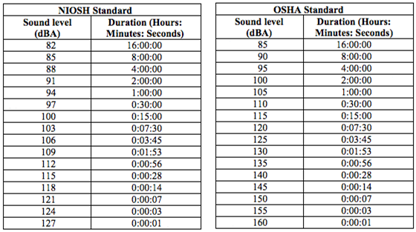
Noise Measurement and Control
NIOSH and OSHA Standards
Tri-Service Hearing Technician 4.2 Certification Course
Notes:
National Institute for Occupational Safety and Health 1998; Occupational Safety and Health Administration 2009. According to each governing body, a person can safely be exposed to each decibel level for its corresponding time without risk of NIHL. For example, according to the OSHA standard, a person can withstand an environment with sound levels at 95dBA for four hours. After four hours they are at risk for NIHL. NIOSH maintains that a person is safe in a 95dBA environment for less than one hour.
(Image: http://www.sengpielaudio.com/PermissibleExposureTime.htm)

Slide 12
Noise Measurement and Control
Noise Controls
Engineering controls - primary means to reduce or control noise
  Dampen, enclose and/or isolate noise
  Erecting barriers between noise source/workers
  Providing lower output tools/machinery
  Use HPDs only after engineering controls
  prove unfeasible or cost prohibitive
  Exceptions: high performance ships, aircraft, tactical vehicles or weaponry
Tri-Service Hearing Technician 4.2 Certification Course
Notes:
Reduce or eliminate noise level at source; baffles/sound absorbing material; preventive maintenance; purchase new, quieter; isolation; consultation by Industrial Hygienist or Audiologist

Slide 13
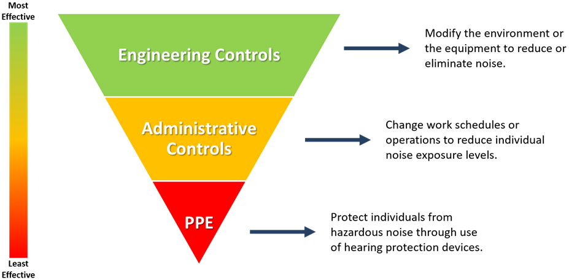
Noise Measurement and Control
Hierarchy of Noise Controls
Tri-Service Hearing Technician 4.2 Certification Course
Notes:
Controlling exposure to noise is the most important method of protecting workers
A hierarchy of controls is used as a means of determining how to implement feasible and effective control solutions
Engineering controls: reduce the noise at the source
Administrative controls: worker rotation or isolation to reduce burden of exposure
Personal protective equipment (PPE): worker use of hearing protection
The effectiveness of the noise control methods decrease across the hierarchy, with Engineering Controls as the most effective to PPE as the least effective
PPE is the least effective, as it relies on daily worker behavior to protect from the hazard
(Image: Created/Provided by Erica Wenner)

Slide 14
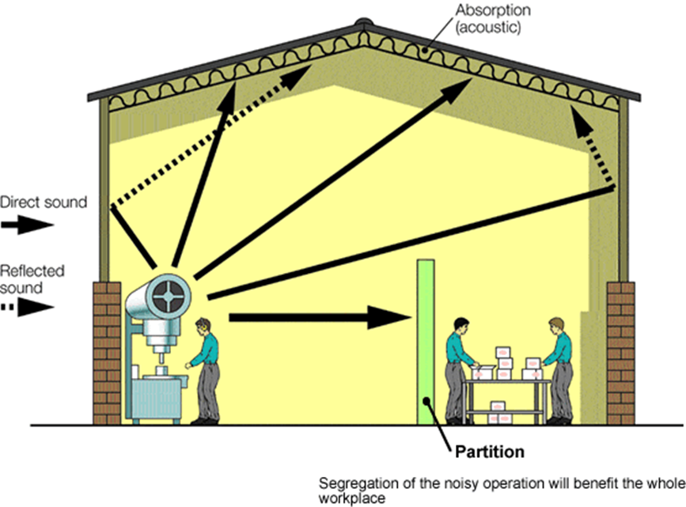
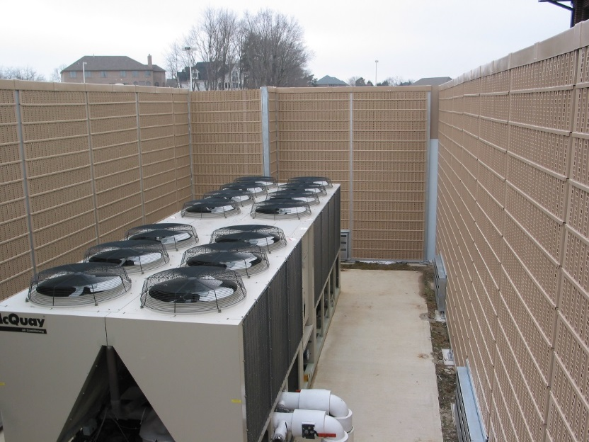
Noise Measurement and Control
Engineering Controls – Source/Path
Tri-Service Hearing Technician 4.2 Certification Course
Notes:
The most effective way to control noise, if substitution and elimination of the noise source are not feasible is engineering controls
Examples: replace/isolate machine, reduce the speed of a machine, reduce compressed air pressure, apply damping material, and replace worn bearings or other vibrating parts
Path: can be direct, indirect or reflected, with different control methods for each type
Reduce noise via carefully designed enclosures around the machine, or treatments to impede the transmission of noise
Examples: sound-absorbing materials – barriers or curtains on walls or ceilings; to reduce sound wave reflections
(Images: http://www.hse.gov.uk/noise/goodpractice/workplacedesign.htm)

Slide 15
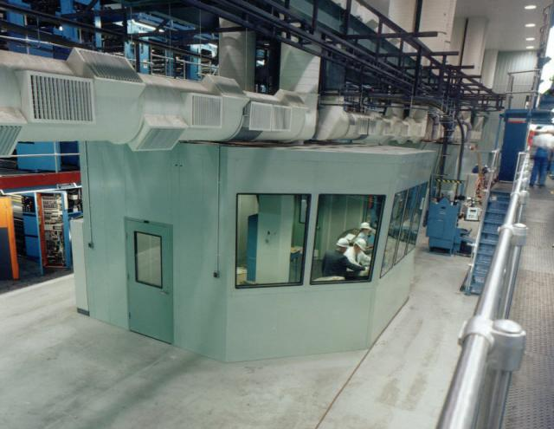
Noise Measurement and Control
Engineering Controls - Receiver
Tri-Service Hearing Technician 4.2 Certification Course
Notes:
Reducing noise in the receiver’s immediate environment, such as a booth or control room around the worker
(Image: http://www.industrialnoisecontrol.com/custom-engineered-noise-control-solutions)

Slide 16
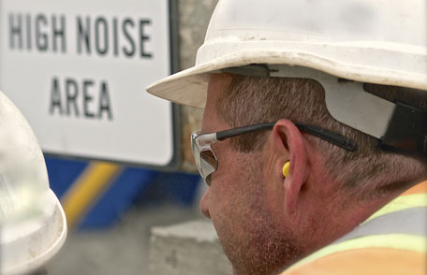
Noise Measurement and Control
Administrative Controls
Personnel rotation
Shift work
Tri-Service Hearing Technician 4.2 Certification Course
Notes:
Rotating of worker out of noisy areas to prevent exceeding the PEL, restricting access to hazardous noise areas
(Image: https://www.cdc.gov/features/protect-hearing-health/index.html)

Slide 17
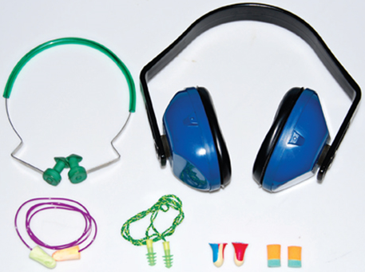
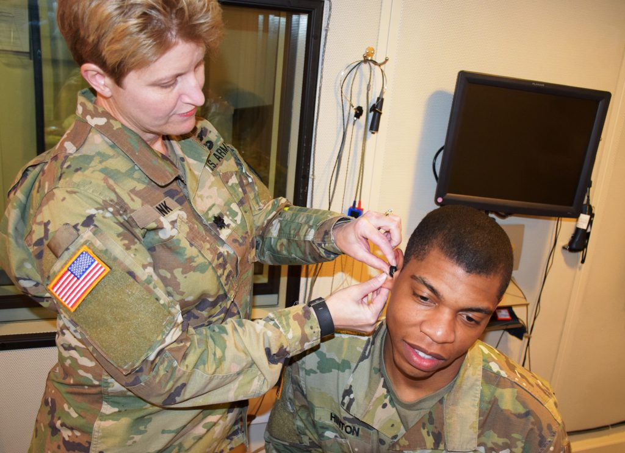
Noise Measurement and Control
Personal Protective Equipment (PPE)
Hearing protection devices (earpro)
Last choice, least effective to control noise
Tri-Service Hearing Technician 4.2 Certification Course
Notes:
Personal protective equipment (hearing protection) is last option because of the variability in attenuation received by the user and the likelihood of consistent use is not predictable
(Images: https://dir.indiamart.com/mumbai/hearing-protection-devices.html; https://www.usveteransmagazine.com/2017/05/19/meet-scientists-changing-way-soldiers-hear/)

Slide 18
Noise Measurement and Control
Terminology
Damage risk criteria
  Risk of acquiring a hearing loss as a result of a specified noise exposure provides a method for determining the acceptable limits of noise exposure, or the maximum safe or allowable noise levels for various frequencies
Permissible exposure limit (PEL) or criterion level
  Agency defined allowable exposure limit (100% dose)
  DoD > 85 dBA TWA for 8-hours, or > 140 dBP impulse noise
  OSHA > 90 dBA for 8-hours or 140 dBP impulse noise
Time-weighted average
  Average sound level or exposure for an 8-hour workday and 40-hour work week
Tri-Service Hearing Technician 4.2 Certification Course
Notes:
Ensure student understand TWA
Equivalent Continuous Level (ECL): the average of several TWAs

Slide 19
Noise Measurement and Control
Terminology
Action level/criterion level
  Trigger point at which personnel are enrolled in the HCP and certain elements must be administered, i.e. education, monitoring audiometry, hearing protection availability
  DoD > 85 dBA TWA for 8 hours, or > 140 dBP impulse noise
  OSHA > 85 dBA
Weighting Scales
  Filter setting on a sound level meter that electronically screens the sound as measured in the ambient environment; common scales are dBA and dBC
Dose
  Percentage of PEL
Tri-Service Hearing Technician 4.2 Certification Course

Slide 20
Noise Measurement and Control
Terminology
Dosimetry
  Use of dosimeters for assessing noise exposure
Exchange Rate (time/intensity tradeoff)
  Time-weighting factor used in average varying levels of noise in an exposure
Noise survey
  Mapping of noise levels to determine need for more detailed assessment
Noise Study
  Established exposures and identifies problem noise sources
Octave band analysis
  Breakdown of a sound into frequency bands
Tri-Service Hearing Technician 4.2 Certification Course

Slide 21
Noise Measurement and Control
Summary
Noise assessment
  Purpose/Process/Goals
  Equipment
  Types of surveys
  Personnel placed in the HCP
Weighting scales
Noise control
  Hierarchy of controls
HPD’s
  Attenuation/Last resort
Terminology
Tri-Service Hearing Technician 4.2 Certification Course

Slide 22
Noise Measurement and Control
? Questions ?
Tri-Service Hearing Technician
4.2 Certification Course

